Slide 1

Abdominal and Genitourinary Injuries
CHAPTER 31

Slide 2
National EMS Education Standard Competencies (1 of 3)
Trauma
Applies fundamental knowledge to provide basic emergency care and transportation based on assessment findings for an acutely injured patient.
Notes:
National EMS Education Standard Competencies
Trauma
Applies fundamental knowledge to provide basic emergency care and transportation based on assessment findings for an acutely injured patient.

Slide 3
National EMS Education Standard Competencies (2 of 3)
Abdominal and Genitourinary Trauma
Recognition and management of
  Blunt versus penetrating mechanisms
  Evisceration
  Impaled object
Notes:
National EMS Education Standard Competencies
Abdominal and Genitourinary Trauma
• Recognition and management of
Blunt versus penetrating mechanisms
Evisceration
Impaled object

Slide 4
National EMS Education Standard Competencies (3 of 3)
Pathophysiology, assessment, and management of
  Solid and hollow organ injuries
  Blunt versus penetrating mechanisms
  Evisceration
  Injuries to the external genitalia
  Vaginal bleeding due to trauma
  Sexual assault
Notes:
National EMS Education Standard Competencies
• Pathophysiology, assessment, and management of
Solid and hollow organ injuries
Blunt versus penetrating mechanisms
Evisceration
Injuries to the external genitalia
Vaginal bleeding due to trauma
Sexual assault

Slide 5
Introduction (1 of 2)
The abdomen extends from the diaphragm to pelvis.
  Contains organs that make up digestive, urinary, and genitourinary systems
Notes:
Lecture Outline
I. Introduction
A. The abdomen extends from the diaphragm to the pelvis and contains the organs that make up the digestive, urinary, and genitourinary systems

Slide 6
Introduction (2 of 2)
Significant trauma to the abdomen can occur from blunt trauma, penetrating trauma, or both.
Injuries to the abdomen that go unrecognized or are not repaired in surgery are a leading cause of traumatic death.
Notes:
Lecture Outline
B. Significant trauma to the abdomen can occur from blunt trauma, penetrating trauma, or both.
1. Injuries to the abdomen that go unrecognized and are not repaired in surgery are a leading cause of traumatic death.

Slide 7
Anatomy and Physiology of the Abdomen (1 of 6)
Abdomen is divided into four general quadrants.
Quadrant of bruising/pain can delineate which organs are involved.
  RUQ: Liver, gallbladder, duodenum, pancreas
  LUQ: Stomach and spleen
  LLQ: Descending colon, left transverse colon
  RLQ: Large and small intestine, appendix
Notes:
Lecture Outline
II. Anatomy and Physiology of the Abdomen
A. Abdominal quadrants
1. The abdomen is divided into four quadrants.
2. The quadrant location of bruising or pain can delineate which organs are possibly involved in a traumatic injury.

Slide 8
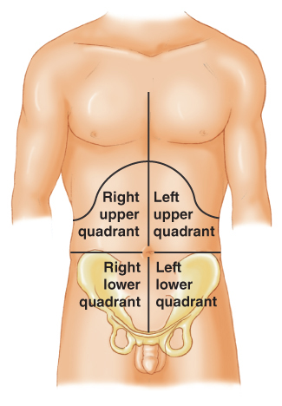
Anatomy and Physiology of the Abdomen (2 of 6)
RLQ is a common location for swelling and inflammation.
The appendix is a source of infection if it ruptures.
FIGURE 31-1 Locations on the abdomen are often designated according to four quadrants.
© Jones & Bartlett Learning.
Notes:
Lecture Outline
a. The RLQ is a common location for swelling and inflammation.

Slide 9
Anatomy and Physiology of the Abdomen (3 of 6)
Hollow organs
  Stomach, intestines, ureters, bladder
  When ruptured or lacerated, contents spill into peritoneal cavity.
    Can cause intense inflammatory reaction and infection such as peritonitis
Notes:
Lecture Outline
B. Hollow and solid organs:
1. The hollow organs of the abdomen include the stomach, intestines, ureters, and bladder.
a. When ruptured or lacerated, the contents spill into the peritoneal cavity causing inflammation and possible infection (peritonitis)
i. Severe abdominal pain, tenderness, and muscular spasm.

Slide 10
Anatomy and Physiology of the Abdomen (4 of 6)
Hollow organs (cont’d)
  Intestinal blood supply comes from mesentery.
    Connects the small intestine to the abdominal wall
    Patients with injuries to the mesentery can bleed into the peritoneal cavity.
Notes:
Lecture Outline
b. Intestinal blood supply comes from the mesentery (fold of tissue that connects the small intestine to the abdominal wall).
i. Patients with injuries to the mesentery can bleed significantly into the peritoneal cavity.
ii. Signs of this include abdominal rigidity and periumbilical bruising.

Slide 11
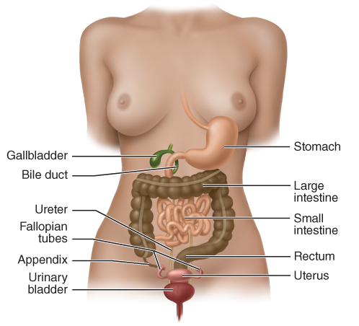
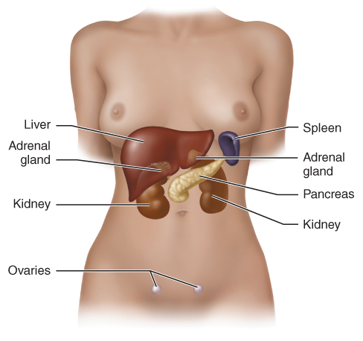
Anatomy and Physiology of the Abdomen (5 of 6)
FIGURE 31-3 The solid organs are solid masses of tissue
that do much of the chemical work in the body and receive a large, rich supply of blood.
FIGURE 31-2 The hollow organs in the abdominal cavity
are structures through which materials pass.
© Jones & Bartlett Learning.
© Jones & Bartlett Learning.
Notes:
These figures show the hollow organs and solid organs of the abdomen.

Slide 12
Anatomy and Physiology of the Abdomen (6 of 6)
Solid organs
  Liver, spleen, pancreas, kidneys
    Perform chemical work of the body: enzyme production, blood cleansing, energy production
    Because of rich blood supply, hemorrhage can be severe.
Notes:
Lecture Outline
2. The solid organs of the abdomen include the liver, spleen, pancreas, and kidneys.
a. These organs perform the chemical work of the body.
i. Enzyme production
ii. Blood cleansing
iii. Endocrine function
iv. Energy production
b. Because of their rich blood supply, hemorrhage of solid organs can be severe.
3. Retroperitoneal space is in the posterior aspect of the abdomen and behind the peritoneum.
a. Contains the kidneys, ureters, urinary bladder, and the majority of the pancreas.

Slide 13
Injuries to the Abdomen
Injuries to the abdomen are considered either open or closed.
Can involve hollow and/or solid organs
Notes:
Lecture Outline
III. Injuries to the Abdomen
A. Abdominal injuries are considered either open or closed and can involve hollow and/or solid organs.

Slide 14
Closed Abdominal Injuries (1 of 4)
Blunt trauma to abdomen
MOIs:
  Motor vehicle crashes
  Motorcycle crashes
  Falls
  Blast injuries
  Pedestrian versus bicycle
  Rapid deceleration
  Compression
Notes:
Lecture Outline
B. Closed abdominal injuries
1. Blunt trauma to abdomen
2. MOIs capable of causing closed injuries:
a. Motor vehicle crashes
b. Motorcycle crashes
c. Falls
d. Blast injuries
e. Pedestrian versus bicycle
f. Rapid deceleration
g. Compression
3. May initially appear as abrasions to the surface of the skin
a. It may take several hours for the contusion or hematoma to become visible

Slide 15
Closed Abdominal Injuries (2 of 4)
Signs and symptoms
  Blood in peritoneal cavity produces acute pain in entire abdomen.
  Abdominal distention is often the result of free fluid, blood, or organ contents spilling into peritoneal cavity.
  Abdominal bruising and discoloration
Notes:
Lecture Outline
3. May initially appear as abrasions to the surface of the skin
a. It may take several hours for the contusion or hematoma to become visible

Slide 16
Closed Abdominal Injuries (3 of 4)
Seat belts
  May cause blunt injuries of abdominal organs
    Particularly when belt lies too high
    Can cause bladder injuries to pregnant patients
  Remember to inspect beneath the airbag for signs of damage to the steering column.
Notes:
Lecture Outline
C. Injuries from seat belts and airbags
1. When worn properly, a seat belt lies below the anterior superior iliac spines of the pelvis and against the hip joints.
a. If belt lies to high, it can squeeze abdominal organs or great vessels against the spine when the car decelerates or stops.
b. Can cause bladder injuries to pregnant patients who adjust the lap belt for comfort.
2. Remember to inspect beneath the airbag for signs of damage to the steering column.

Slide 17
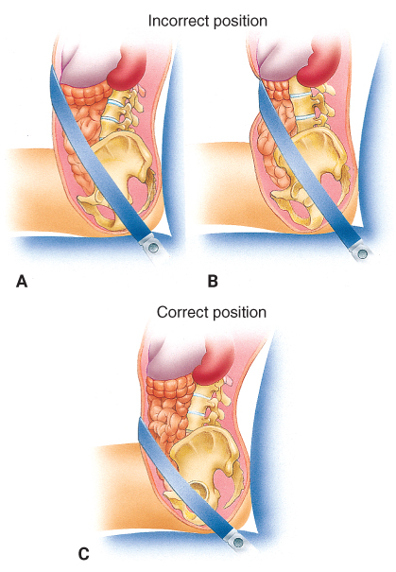
Closed Abdominal Injuries (4 of 4)
FIGURE 31-5 Diagrams A and B show improper positioning of lap seat belts. The proper position for a seat belt is below the anterior superior iliac spines of the pelvis and against the hip joints, as shown in diagram C.
A, B, C: © Jones & Bartlett Learning.
Notes:
These figures shows the correct and incorrect placement of a seat belt.

Slide 18
Open Abdominal Injuries (1 of 5)
Foreign object enters abdomen and opens peritoneal cavity to the outside.
Open wounds can be deceiving.
  Maintain a high index of suspicion.
Notes:
Lecture Outline
D. Open abdominal injuries
1. Injuries in which a foreign object enters the abdomen and opens the peritoneal cavity to the outside
a. Open wounds can be deceiving; therefore, you should maintain a high index of suspicion for unseen injuries, internal damage to organs, and potential life-threatening injuries.

Slide 19
Open Abdominal Injuries (2 of 5)
Damage depends on velocity of object.
  Low-velocity injuries
    Knives, other edged weapons
  Medium-velocity injuries
    Smaller caliber handguns and shotguns
  High-velocity injuries
    High-powered rifles and handguns
Notes:
Lecture Outline
2. The velocity of the object can help predict the amount of damage to tissue.
a. Low-velocity injuries
i. Caused by handheld or hand-powered objects, such as knives and other edged weapons
b. Medium-velocity injuries
i. Caused by smaller caliber handguns and shotguns
c. High-velocity injuries
i. Caused by larger weapons, such as high-powered rifles and higher-powered handguns

Slide 20
Open Abdominal Injuries (3 of 5)
High- and medium-velocity injuries
  Have temporary wound channels
  Caused by cavitation
    Cavity forms as pressure wave from projectile transfers to tissues.
    Can produce large amounts of bleeding
Notes:
Lecture Outline
d. High- and medium-velocity injuries have temporary wound channels in addition to exit and entrance wounds.
i. Cavitation occurs as the pressure wave from the projectile is transferred to the tissues.
ii. The higher the velocity of the projectile, the larger the cavity it produces.

Slide 21
Open Abdominal Injuries (4 of 5)
Low-velocity injuries
  Also have capacity to damage organs
  Internal injury may not be apparent.
  If injury is at or below xiphoid process, assume it has affected the thoracic and peritoneal cavities.
Notes:
Lecture Outline
e. Low-velocity penetrations also have the capacity to damage underlying organs.
i. Internal injury may not be apparent during physical examination.
ii. Any time a patient has an injury at or below the xiphoid process, it should be assumed that the thoracic and peritoneal cavities have been violated.

Slide 22
Open Abdominal Injuries (5 of 5)
Evisceration: bowel protrudes from peritoneum
  Can be painful and visually shocking
  Do not push down on abdomen.
  Only perform visual assessment.
  Cut clothing close to wound.
  Never pull on clothing stuck to or in the wound channel.
Notes:
Lecture Outline
3. In evisceration, bowel protrudes from the peritoneum.
a. Can be extremely painful and is also visually shocking.
b. Do not push down on the patient’s abdomen.
c. Only perform a visual assessment when there is any suspicion of this type of injury.
d. Cut clothing close to the wound.
e. Never pull on any clothing stuck to or in the wound channel.

Slide 23
Hollow Organ Injuries (1 of 2)
Often have delayed signs and symptoms
Spill contents into abdomen
  Infection develops, which can take hours or days.
  Stomach and intestines can leak highly toxic and acidic liquids into peritoneal cavity.
Notes:
Lecture Outline
E. Hollow organ injuries
1. Often have delayed signs and symptoms
2. Commonly spill contents into the abdomen.
a. Infection develops, which can take hours or days.

Slide 24
Hollow Organ Injuries (2 of 2)
Caused by blunt and penetrating trauma
  Blunt trauma causes organ to “pop,” releasing fluids and air.
  Penetrating trauma causes direct injury.
Gallbladder and urinary bladder
  Contents are damaging.
Air in peritoneal cavity causes pain.
  Can cause ischemia and infarction
Notes:
Lecture Outline
3. Both blunt and penetrating trauma can cause hollow organ injuries.
a. Blunt trauma causes the organ to “pop,” releasing fluids and air.
b. Penetrating trauma causes direct injury, such as lacerations and punctures.
4. The gallbladder and the urinary bladder are hollow organs whose contents are potentially irritating and damaging if ruptured.
a. These fluids move into loose spaces and voids in the peritoneal cavity, eventually leading to infection.
5. Free air in the peritoneal cavity produces pain.
a. Usually indicates that a hollow organ or loop of bowel has perforated
b. If not rapidly identified and repaired, severe infection and septic shock may develop.

Slide 25
Solid Organ Injuries (1 of 5)
Can bleed significantly and cause rapid blood loss
  Can be hard to identify from physical exam
  Slowly ooze blood into peritoneal cavity
Notes:
Lecture Outline
F. Solid organ injuries
1. Solid organs can bleed significantly and cause rapid blood loss.
a. Can be hard to identify from a physical exam because the patient is not experiencing significant pain.
b. Solid organs can also slowly ooze blood into the peritoneal cavity, causing pain to increase slowly over time.

Slide 26
Solid Organ Injuries (2 of 5)
Liver is the largest organ in abdomen.
  Vascular and can lead to hypoperfusion
    Often injured by fractured lower right rib or penetrating trauma
    Referred pain to the right shoulder is a common finding with an injured liver.
Notes:
Lecture Outline
2. The liver is the largest organ in the abdomen.
a. Very vascular and can contribute to hypoperfusion if injured
b. Often injured by a fractured lower right rib or a penetrating trauma
c. A common assessment finding is referred pain to the right shoulder.

Slide 27
Solid Organ Injuries (3 of 5)
Spleen and pancreas
  Vascular and prone to heavy bleeding
  Spleen is often injured.
    Motor vehicle collisions
    Steering wheel trauma
    Falls from heights
    Bicycle and motorcycle accidents involving handlebars
Notes:
Lecture Outline
3. The spleen and pancreas are also very vascular.
a. Both are prone to heavy bleeding when fractured, lacerated, or punctured.
b. Referred left shoulder pain also occurs in some cases of splenic injury.

Slide 28
Solid Organ Injuries (4 of 5)
Diaphragm
  When penetrated or ruptured, loops of bowels invade thoracic cavity.
    Patient may exhibit dyspnea.
Notes:
Lecture Outline
4. If the diaphragm is penetrated or ruptured, loops of bowels may herniate into the thoracic cavity.
a. Patients may exhibit dyspnea
b. Change in position from upright to supine results in more abdominal contents spilling into the thoracic cavity and compressing the lungs, prohibiting the lungs from fully expanding.

Slide 29
Solid Organ Injuries (5 of 5)
Kidneys
  Can cause significant blood loss
  Common finding is blood in urine.
  Blood visible on urinary meatus indicates significant trauma to genitourinary system.
Notes:
Lecture Outline
5. The kidneys can also be impacted or penetrated by trauma.
a. Can cause significant amounts of blood loss
b. Common finding is blood in the urine (hematuria)
c. Blood visible on inspection of the urinary meatus indicates significant trauma to the genitourinary system.

Slide 30
Patient Assessment of Abdominal Injuries
Assessment of abdominal injuries is difficult.
  Causes of injury may be apparent but resulting tissue damage may not be.
  Patient may be overwhelmed with more painful injuries.
  Some injuries develop and worsen over time.
Notes:
Lecture Outline
IV. Patient Assessment of Abdominal Injuries
A. Assessment finding in patients with potential abdominal injuries can be challenging to interpret.
1. Some are obvious; however, many are easy to overlook.
2. Patient may be overwhelmed with other more painful injuries.
3. Some abdominal injuries develop and worsen over time.

Slide 31
Scene Size-up (1 of 2)
Scene size-up
  Standard precautions of gloves and eye protection should be a minimum.
  Be sure scene is safe for you.
  Call for additional resources early if needed.
Notes:
Lecture Outline
B. Scene size-up
1. Be sure the scene is safe for you.
2. Call for additional resources early if needed.

Slide 32
Scene Size-up (2 of 2)
Mechanism of injury/nature of illness
  Observe the scene for early indicators of MOI.
  Consider early spinal precautions.
  Consider all of the injuries the MOI could have produced.
Notes:
Lecture Outline
3. Mechanism of injury/nature of illness
a. Consider early spinal precautions.
b. Consider all of the injuries the MOI could have produced.

Slide 33
Primary Assessment (1 of 2)
Quickly form a general impression and note the patient’s level of consciousness.
Severe external hemorrhage must be addressed before airway or breathing.
Ensure that the patient has a patent airway.
Notes:
Lecture Outline
C. Primary assessment
1. Quickly form a general impression and note the patient’s level of consciousness.
2. Severe external hemorrhage must be addressed before airway or breathing concerns.
3. Ensure that the patient has a clear and patent airway.

Slide 34
Primary Assessment (2 of 2)
Circulation
  Treat signs and symptoms of shock aggressively.
Transport decision
  Patients with abdominal injuries should be evaluated at the highest level of trauma center available.
Notes:
Lecture Outline
4. Circulation
a. Treat signs and symptoms of shock aggressively.
5. Transport decision
a. Patients with abdominal injuries should be evaluated at the highest level of trauma center available.

Slide 35
History Taking (1 of 2)
Investigate chief complaint and MOI
  Identify signs, symptoms, and pertinent negatives.
  Movement of body or abdominal organs irritates peritoneum, causing pain.
Notes:
Lecture Outline
D. History taking
1. SAMPLE history and OPQRST
a. Ask if the patient has experienced any nausea, vomiting, or diarrhea.
b. Ask about the appearance of any bowel movements and urinary output.
c. Ask about referred pain.
d. Peritonitis can result in pain provoked by removal of pressure (rebound tenderness).
e. Guarding occurs when the patient tenses up or stiffens his or her abdominal muscles.

Slide 36
History Taking (2 of 2)
SAMPLE history
  Use OPQRST to help explain injury.
  Ask if there is nausea, vomiting, or diarrhea.
  Ask about appearance of any bowel movements and urinary output.
Notes:
Lecture Outline
1. SAMPLE history and OPQRST
a. Ask if the patient has experienced any nausea, vomiting, or diarrhea.
b. Ask about the appearance of any bowel movements and urinary output.
c. Ask about referred pain.
d. Peritonitis can result in pain provoked by removal of pressure (rebound tenderness).
e. Guarding occurs when the patient tenses up or stiffens his or her abdominal muscles.

Slide 37
Secondary Assessment (1 of 5)
May not have time to perform in the field
Physical examinations
  Inspect for bleeding.
  Remove or loosen clothes to expose injuries.
  Patient should remain in position of comfort.
  Examine entire abdomen.
Notes:
Lecture Outline
E. Secondary assessment
1. May not have time to perform this detailed, comprehensive exam in critically injured patients
2. Physical examinations
a. Remove or loosen clothes to expose injured regions of the body.
b. Transport the patient in a position of comfort unless spinal injury is suspected.
c. Examine the entire abdomen, including all posterior, anterior, and lateral surfaces.

Slide 38
Secondary Assessment (2 of 5)
Physical examinations (cont’d)
  Use DCAP-BTLS.
    Inspect and palpate for deformities.
    Look for presence of contusions, abrasions, puncture wounds, penetrating injuries, burns.
    Palpate for tenderness and attempt to localize to specific quadrant of abdomen.
    Swelling may indicate significant intra-abdominal injury.
Notes:
Lecture Outline
d. Use DCAP-BTLS to help identify specific signs and symptoms of injury.

Slide 39
Secondary Assessment (3 of 5)
Physical examinations (cont’d)
  Palpate the quadrant farthest away from quadrant exhibiting signs of injury and pain.
    Allows you to investigate possibility of radiation of pain
  Perform full-body scan to identify injuries.
    If you find life threat, stop and treat it.
    Assess need for spinal immobilization.
Notes:
Lecture Outline
e. Palpate the abdomen when examining the region.
i. Palpate the quadrant farthest away from the quadrant that is exhibiting signs and symptoms of injury and pain.
f. Perform a full-body scan to identify injuries other than abdominal injuries.

Slide 40
Secondary Assessment (4 of 5)
Physical examinations (cont’d)
  Inspect and palpate kidney area for tenderness, bruising, swelling, or other trauma signs.
    Hollow organs will spill contents into peritoneal cavity.
Notes:
Lecture Outline
g. Inspect and palpate the kidney area for tenderness, bruising, swelling, or other signs of trauma.

Slide 41
Secondary Assessment (5 of 5)
Vital signs
  Many abdominal emergencies can cause a rapid pulse and low blood pressure.
  Record of vital signs will help identify changes in condition.
  Use appropriate monitoring devices.
Notes:
Lecture Outline
3. Obtain vital signs
a. Obtain and record vital signs early, and repeat every 5 minutes in the patient whom you suspect has a serious injury.
b. Hypotension is a late sign of shock.

Slide 42
Assessment of an Isolated Abdominal Injury
Visually inspect the abdomen for penetrating wounds.
If an entrance wound is found, check for a corresponding exit wound.
Do not remove an impaled object.
Notes:
Lecture Outline
F. Assessment of an isolated abdominal injury
1. Visually inspect the abdomen for penetrating wounds.
2. If an entrance wound is found, check for a corresponding exit wound.
3. Do not remove an impaled object.

Slide 43
Reassessment
Repeat the primary assessment and reassess vital signs.
Reassess interventions and treatment.
Communication and documentation
  Outline the patient’s MOI, injuries, and relevant vital signs.
Notes:
Lecture Outline
G. Reassessment
1. Repeat the primary assessment and vital signs.
a. Reassess the interventions and treatment you have provided.
2. Communication and documentation
a. Outline the patient’s MOI, injuries, and relevant vital signs.

Slide 44
Emergency Medical Care of Abdominal Injuries (1 of 6)
Closed abdominal injuries
  Monitor and evaluate for progression into shock.
  The patient may experience nausea and vomiting.
  Administer oxygen to patients who are unconscious or in shock.
  Assist ventilations if necessary.
  Consider calling ALS for gastric tube placement.
Notes:
Lecture Outline
V. Emergency Medical Care of Abdominal Injuries
A. Closed abdominal injuries
1. Monitor the patient closely and evaluate for progression into shock.
2. The patient may experience nausea and vomiting; have suction available.
3. Administer oxygen to patients who are unconscious or who are in shock.
4. Keep the patient warm.
5. Assist ventilations if necessary.
6. Consider calling ALS for placement of an oral or nasal gastric tube.

Slide 45
Emergency Medical Care of Abdominal Injuries (2 of 6)
Open abdominal injuries
  Patients with penetrating injuries
    Generally obvious wounds, external bleeding
    Maintain a high index of suspicion for serious unseen blood loss.
Notes:
Lecture Outline
B. Open abdominal injuries
1. Patients with penetrating injuries
a. Generally obvious wounds and external bleeding; however, significant external bleeding is not always present
b. Maintain a high index of suspicion for serious, unseen blood loss.

Slide 46
Emergency Medical Care of Abdominal Injuries (3 of 6)
Open abdominal injuries (cont’d)
  Inspect patient’s back and sides for exit wound.
  Apply dry, sterile dressing to all open wounds.
  If penetrating object is still in place, apply stabilizing bandage around it.
Notes:
Lecture Outline
c. Follow the general procedures described previously for care of a blunt abdominal injury, as well as:
i. Inspect the patient’s back and sides for an exit wound.
ii. Apply a dry, sterile dressing to all open wounds.
iii. If the penetrating object is still in place, apply a stabilizing bandage around it to control external bleeding and to minimize movement of the object.

Slide 47
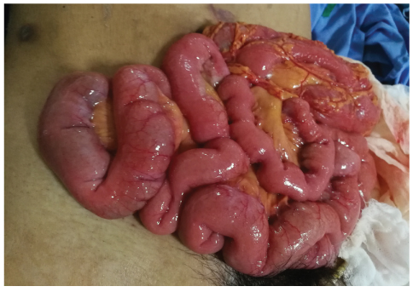
Emergency Medical Care of Abdominal Injuries (4 of 6)
Evisceration
  Severe lacerations of abdominal wall may result in internal organs or fat protruding through wound.
FIGURE 31-10 An abdominal evisceration is an open abdominal wound from which internal organs protrude.
© Arucha Srimuang/Shutterstock.
Notes:
Lecture Outline
d. Severe lacerations of the abdominal wall may result in evisceration.

Slide 48
Emergency Medical Care of Abdominal Injuries (5 of 6)
Evisceration (cont’d)
  Never try to replace a protruding organ.
  Keep the organs moist and warm.
  Cover with moistened, sterile dressings.
  Secure dressing with bandage.
  Secure bandage with tape.
Notes:
Lecture Outline
i. Place a sterile dressing moistened with saline over the wound, apply a bandage, and transport.
ii. Never try to replace a protruding organ.
iii. Keep the affected area warm.

Slide 49
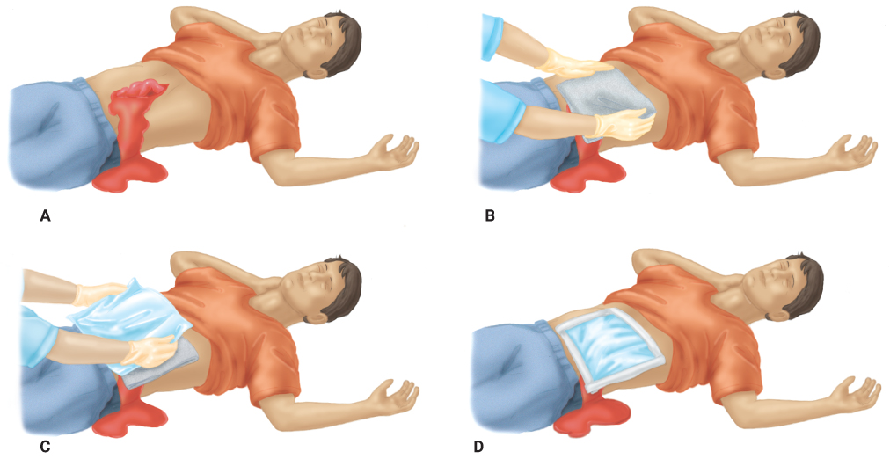
Emergency Medical Care of Abdominal Injuries (6 of 6)
FIGURE 31-11 A. The open abdomen radiates body heat rapidly and must be covered. B. Cover the wound with moistened, sterile dressings and with an occlusive dressing, depending on local protocol. C. Secure the dressing with a bandage. D. Secure the bandage with tape.
A-D: © Jones & Bartlett Learning.
Notes:
These figures show the steps to apply a dressing to an open abdominal injury.

Slide 50
Anatomy of the Genitourinary System (1 of 3)
Controls reproductive functions and waste discharge
  Organs of the genitourinary system are located in the abdomen.
  Male genitalia lie outside pelvic cavity.
  Female genitalia lie within pelvic cavity.
Notes:
Lecture Outline
VI. Anatomy of the Genitourinary System
A. The genitourinary system controls reproductive functions and waste discharge.
1. Organs of the genitourinary system are located in the abdomen
a. Kidneys are solid organs.
b. Ureters, bladder, and urethra are hollow organs.
2. The male genitalia lie outside the pelvic cavity, except for the prostate gland and seminal vesicles.
3. The female genitalia are contained entirely within the pelvis, except the vulva, clitoris, and labia.

Slide 51
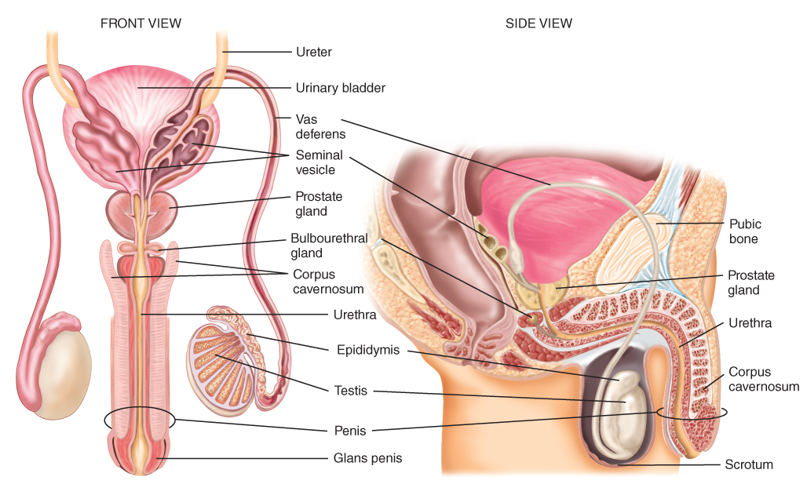
Anatomy of the Genitourinary System (2 of 3)
FIGURE 31-13 The male reproductive system includes the testicles, vas deferens, seminal vesicles, prostate gland, urethra, and penis.
© Jones & Bartlett Learning.
Notes:
This figure shows the organs of the male reproductive system.

Slide 52
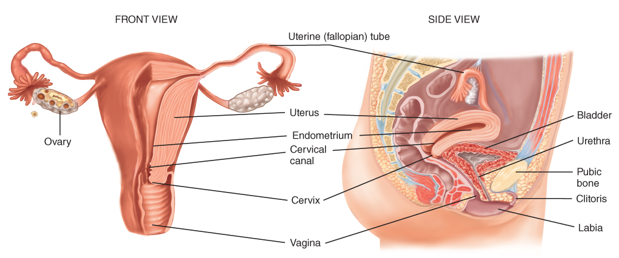
Anatomy of the Genitourinary System (3 of 3)
FIGURE 31-14 The female reproductive system includes the ovaries, fallopian tubes, uterus, cervix, and vagina.
© Jones & Bartlett Learning.
Notes:
This figure shows the organs of the female reproductive system.

Slide 53
Injuries of the Genitourinary System (1 of 7)
Kidney injuries
  Not uncommon and rarely occur in isolation
  Kidneys lie in well-protected area.
    Forceful blow or penetrating injury often involved
Notes:
Lecture Outline
VII. Injuries of the Genitourinary System
A. Kidney injuries
1. Not uncommon and rarely occur in isolation
a. A forceful blow or penetrating injury is often involved.
b. Less significant injuries can result from an indirect blow such as a football tackle.

Slide 54
Injuries of the Genitourinary System (2 of 7)
Suspect kidney damage if patient has evidence of any of the following:
  Abrasion, laceration, contusion on the flank
  Penetrating wound in region of flank or upper abdomen
  Fractures on either side of lower rib cage or of lower thoracic or upper lumbar vertebrae
  A hematoma in the flank region
Notes:
Lecture Outline
2. Suspect kidney damage if the patient has a history or physical evidence of any of the following:
a. An abrasion, laceration, or contusion on the flank
b. A penetrating wound in the region of the lower rib cage and above the hip (flank) or the upper abdomen
c. Fractures on either side of the lower rib cage or of the lower thoracic or upper lumbar vertebrae
d. A hematoma in the flank region

Slide 55
Injuries of the Genitourinary System (3 of 7)
Urinary bladder injuries
  May result in rupture
    Urine spills into surrounding tissues.
    Blunt injuries to lower abdomen or pelvis can rupture urinary bladder.
  In males, sudden deceleration can shear the bladder from the urethra.
  In later trimesters of pregnancy, bladder injuries increase.
Notes:
Lecture Outline
B. Urinary bladder injuries
1. May result in rupture
a. Urine spills into surrounding tissues.
b. Blunt injuries to lower abdomen or pelvis can cause rupture to the urinary bladder, particularly when the bladder is full and distended.
c. Penetrating wounds of the lower mid-abdomen or the perineum can directly involve the urinary bladder.
2. In males, sudden deceleration from a motor vehicle or motorcycle crash can shear the bladder from the urethra.
3. In later trimesters of pregnancy, bladder injuries increase from displacement of the uterus.

Slide 56
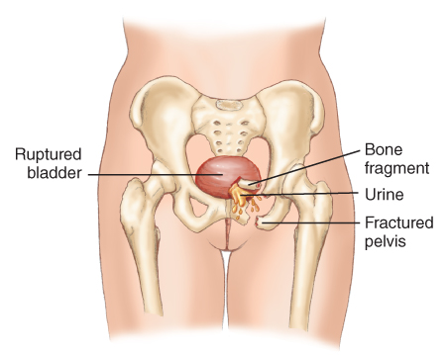
Injuries of the Genitourinary System (4 of 7)
FIGURE 31-16 Fracture of the pelvis can result in perforation of the bladder by the bony fragments. Urine then leaks into the pelvis.
© Jones & Bartlett Learning.
Notes:
This figure shows how a fracture of the pelvis can result in perforation of the bladder.

Slide 57
Injuries of the Genitourinary System (5 of 7)
External male genitalia injuries
  Soft-tissue wounds
  Painful and of great concern for patient
    Rarely life threatening
    Should not be given priority over more severe wounds unless there is severe bleeding
    Pain may be referred to the lower abdomen.
Notes:
Lecture Outline
C. External male genitalia injuries
1. Soft-tissue wounds
2. Painful and of great concern for the patient, but rarely life threatening
a. Rarely life threatening
b. Should not be given priority over more severe wounds unless there is significant bleeding
c. Pain may be referred to the lower abdomen

Slide 58
Injuries of the Genitourinary System (6 of 7)
Female genitalia injuries
  Internal female genitalia
    Uterus, ovaries, fallopian tubes are rarely damaged.
    Exception is pregnant uterus.
      Uterus enlarges substantially and rises out of pelvis.
      Injuries can be serious.
      Also keep fetus in mind.
Notes:
Lecture Outline
D. Female genitalia injuries
1. Internal female genitalia
a. The uterus, ovaries, and fallopian tubes are rarely damaged.
i. Small, deep in the pelvis, and well protected
b. Exception is the pregnant uterus
i. Uterus enlarges substantially and rises out of the pelvis.
ii. Injuries can be serious because the uterus has a rich blood supply during pregnancy.
iii. Also keep the fetus in mind.

Slide 59
Injuries of the Genitourinary System (7 of 7)
Female genitalia injuries (cont’d)
  External female genitalia
    Vulva, clitoris, major and minor labia
    Very rich nerve supply
    Consider sexual assault and pregnancy.
    If external bleeding, a sterile absorbent sanitary pad may be applied to the labia.
    Do not insert anything into the vagina.
Notes:
Lecture Outline
2. External female genitalia
a. Includes the vulva, clitoris, and the major and minor labia at the entrance of the vagina
b. Very rich nerve supply, so injuries are very painful
c. Consider sexual assault and pregnancy.
i. Ask patient about last known menstrual period.
ii. Ask about sexual history.
iii. Assume all women of childbearing age are possibly pregnant.
d. In cases of external bleeding and trauma, a sterile absorbent sanitary napkin or pad may be applied to the labia.
e. Do not insert instruments, gloved fingers, or a tampon into the vagina.

Slide 60
Patient Assessment of the Genitourinary System
Potential for patient embarrassment
  Maintain a professional presence.
  Provide privacy.
  Have EMT of same gender perform assessment.
Notes:
Lecture Outline
VIII. Patient Assessment of the Genitourinary System
A. Potential for patient embarrassment
1. Maintain a professional presence.
2. Provide privacy during assessment.
3. When possible, have an EMT of the same gender perform the assessment.

Slide 61
Scene Size-up
Scene safety
  Assess the scene for hazards and threats.
  Apply standard precautions.
Look for indicators of MOI.
  Patient may avoid discussion to avoid undergoing physical exam.
  Patient may provide an MOI that seems less embarrassing than the actual MOI.
Notes:
Lecture Outline
B. Scene size-up
1. Assess the scene for hazards and threats to crew safety.
2. Apply standard precautions
3. Look for indicators of the MOI.
i. Patient may avoid the discussion to avoid undergoing a physical examination.
ii. Patient may also provide an MOI that seems “less embarrassing” than the actual MOI.

Slide 62
Primary Assessment (1 of 4)
Quickly scan patient to identify and treat life threats.
  Genitourinary system is very vascular.
    Life-threatening hemorrhage must be addressed immediately.
Notes:
Lecture Outline
C. Primary assessment
1. Quickly scan the patient to identify and treat life threats.
a. Genitourinary system is very vascular.
i. Injuries can produce a significant volume of blood.
b. Do not avoid this area in the rapid scan.
i. If bleeding is present, maintain privacy for the patient and inspect exterior genitals for visible injury.
2. Control severe bleeding first.

Slide 63
Primary Assessment (2 of 4)
Airway and breathing
  Ensure the patient has a clear and patent airway.
    Provide assisted ventilations with bag-mask device as needed.
  Consider advanced airway if patient is unresponsive.
Notes:
Lecture Outline
3. Ensure that the patient has a clear and patent airway.
a. Provide assisted ventilations with a bag-mask device as needed.
4. Consider the need for spinal motion restriction

Slide 64
Primary Assessment (3 of 4)
Circulation
  Assess pulse rate and quality.
  Closed injuries do not have visible signs of bleeding.
  Treat for shock.
Notes:
Lecture Outline
5. Circulation
a. Assess the pulse rate and quality, determine the skin condition, color, and temperature, and assess capillary refill.
b. Closed injuries do not have visible signs of bleeding.
c. Treat for signs of shock.
6. Note the patient’s level of alertness

Slide 65
Primary Assessment (4 of 4)
Transport decision
  Any injury to the genitourinary system can be life altering.
    Transport to a trauma center.
Notes:
Lecture Outline
7. Transport decision
a. Transport to a trauma center.

Slide 66
History Taking (1 of 2)
Investigate chief complaint.
  Common associated complaints with genitourinary injuries are:
    Nausea and vomiting
    Diarrhea
    Blood in urine
    Vomiting blood
    Abnormal bowel and bladder habits
Notes:
Lecture Outline
D. History taking
1. Investigate chief complaint.
a. Common associated complaints with genitourinary injuries are:
i. Nausea and vomiting
ii. Diarrhea
iii. Blood in urine (hematuria)
iv. Vomiting blood (hematemesis)
v. Abnormal bowel and bladder habits

Slide 67
History Taking (2 of 2)
SAMPLE history
  Use OPQRST to learn about patient’s pain.
  Ask patient about output.
    Especially blood in urine
  Ask about allergies.
  Last intake of food and fluid
  Address events leading up to injury.
Notes:
Lecture Outline
2. SAMPLE history
a. Use OPQRST to learn about the patient’s pain.
b. Ask patient about output from the genitourinary system.
i. Especially blood in the urine
c. Ask about allergies to medications or environmental triggers.
d. Repeated or previous injuries or illness can help determine the extent of the current injury or illness.
e. Last intake of food and fluids is important because it can predict the genitourinary system’s contents.
f. Address the events leading up to the injury.

Slide 68
Secondary Assessment
Physical examinations
  Genitourinary system injuries can be awkward to assess and treat.
  Focus on specific region of body when isolated injury is present.
  Look for DCAP-BTLS.
  Identify wounds and control bleeding.
  Obtain vital signs and reassess frequently.
Notes:
Lecture Outline
E. Secondary assessment
1. There are times when you will be unable to conduct a secondary assessment:
a. The need to provide ongoing life-saving treatment
b. Short transport time
2. When patient has an isolated injury, focus on that and the body region affected.
3. Assess for DCAP-BTLS.
4. Obtain the patient’s vital signs and reassess frequently

Slide 69
Reassessment
Interventions
  Repeat primary assessment and vital signs.
  Reassess interventions and treatment.
  Adjust interventions as needed.
Communication and documentation
  Communicate all concerns to hospital staff.
  Describe and document all injuries and treatments given.
Notes:
Lecture Outline
F. Reassessment
1. Repeat the primary assessment and vital signs.
2. Reassess the interventions and treatment you have provided.
3. Adjust interventions as necessary
4. Communication and documentation
a. Communicate your concerns to the hospital staff.
b. Describe all injuries and treatment given.

Slide 70
Emergency Medical Care of Genitourinary Injuries (1 of 11)
Kidney injuries
  Injuries may not be obvious.
    You will see signs of shock and blood in urine.
  Treat for shock, transport promptly, and monitor vital signs en route.
Notes:
Lecture Outline
IX. Emergency Medical Care of Genitourinary Injuries
A. Kidneys
1. Damage may not be obvious upon inspection.
a. You may see signs of shock and/or blood in the urine
2. Treat for shock, transport promptly, and monitor vital signs en route to the hospital.

Slide 71
Emergency Medical Care of Genitourinary Injuries (2 of 11)
Urinary bladder injury
  Suspect if you see:
    Blood at urethral opening
    Signs of trauma to lower abdomen, pelvis, or perineum
  In presence of shock or associated injuries:
    Transport promptly.
    Monitor vital signs en route.
Notes:
Lecture Outline
B. Urinary bladder
1. Suspect a urinary bladder injury if you see:
a. Blood at urethral opening
b. Signs of trauma to the lower abdomen, pelvis, or perineum
2. If shock or associated injuries are present, transport promptly and monitor vital signs en route.

Slide 72
Emergency Medical Care of Genitourinary Injuries (3 of 11)
External male genitalia
  Make patient comfortable.
  Use sterile, moist compresses to cover areas stripped of skin.
  Apply direct pressure with dry, sterile gauze dressings to control bleeding.
  Never move or manipulate foreign objects in urethra.
Notes:
Lecture Outline
C. External male genitalia
1. A few general rules for the treatment of injuries to the external male genitalia:
a. Injuries are painful; make the patient comfortable.
b. Use sterile, moist compresses to cover areas stripped of skin.
c. Apply direct pressure with dry, sterile gauze dressings to control bleeding.
d. Never move or manipulate foreign objects in the urethra.

Slide 73
Emergency Medical Care of Genitourinary Injuries (4 of 11)
External male genitalia (cont’d)
  Identify and take avulsed parts in bag to hospital with patient.
  Amputation of penile shaft
    Managing blood loss is top priority.
      Use local pressure with sterile dressing.
    Surgical reconstruction is possible if you can locate the amputated part.
Notes:
Lecture Outline
e. Identify and take avulsed parts to the hospital with patient.
i. If patient has an avulsion of skin on the penis:
(a) Wrap the penis in a soft, sterile dressing moistened with sterile saline.
(b) Transport promptly.
(c) Use direct pressure to control any bleeding.
(d) Try to save and preserve the avulsed skin.
2. Amputation of penile shaft
a. Managing blood loss is the top priority.
i. Use local pressure with a sterile dressing on the remaining stump.
b. Never apply a constricting device.
c. Surgical reconstruction is possible if you can locate the amputated part.
i. Wrap it in a moist, sterile dressing.
ii. Place it in a bag.
iii. Transport it in a cooled container without it directly touching ice.

Slide 74
Emergency Medical Care of Genitourinary Injuries (5 of 11)
External male genitalia (cont’d)
  When an erect penis is bent sharply, the shaft can be severely damaged.
    Sometimes requires surgical repair
    Associated with intense pain, bleeding, and fear
Notes:
Lecture Outline
3. If the connective tissue surrounding the erectile tissue is severely damaged, the shaft can be fractured or severely angled.
a. Sometimes requires surgical repair
b. Associated with intense pain, bleeding into the tissues, and fear.

Slide 75
Emergency Medical Care of Genitourinary Injuries (6 of 11)
External male genitalia (cont’d)
  Laceration of head of penis
    Associated with heavy bleeding
    Apply local pressure with sterile dressing.
  Skin of shaft or foreskin caught in zipper
    If small segment of zipper is involved, try to unzip.
    If long segment of zipper is involved, cut the zipper out of the pants with heavy scissors.
Notes:
Lecture Outline
4. Accidental laceration of the head of the penis is associated with heavy bleeding.
a. Local pressure with a sterile dressing usually stops the hemorrhage.
5. Skin of shaft or foreskin can get caught in the zipper of pants.
a. If small segment of the zipper is involved, you can try to unzip the pants.
b. If a longer segment is involved, use heavy scissors to cut the zipper out of the pants to make the patient more comfortable.

Slide 76
Emergency Medical Care of Genitourinary Injuries (7 of 11)
External male genitalia (cont’d)
  Urethral injuries are not uncommon.
    Straddle injuries, pelvic fractures, and penetrating wounds of the perineum
    Important to know if patient can urinate and if there is blood in urine
    Foreign bodies protruding from urethra will have to be surgically removed.
Notes:
Lecture Outline
6. Urethral injuries in the male are not uncommon.
a. Lacerations of the urethra can result from:
i. Straddle injuries
ii. Pelvic fractures
iii. Penetrating wounds of the perineum
b. It is important to know if the patient can urinate and if there is blood in the urine.
i. Save any urination for later examination at the hospital.
c. Any foreign bodies protruding from the urethra will have to be surgically removed.

Slide 77
Emergency Medical Care of Genitourinary Injuries (8 of 11)
External male genitalia (cont’d)
  Avulsion of the skin of the scrotum may damage scrotal contents.
    Preserve avulsed skin in a moist sterile dressing.
    Wrap scrotal contents or perineal area with a sterile moist compress.
  Direct blows to scrotum can result in rupture of a testicle or accumulation of blood around testes.
    Apply ice to scrotal area.
Notes:
Lecture Outline
7. Avulsion of the skin of the scrotum may damage the scrotal contents.
a. Preserve the avulsed skin in a moist sterile dressing for possible use in reconstruction.
b. Wrap the scrotal contents or the perineal area with a sterile moist compress and use a local pressure dressing to control bleeding.
8. Direct blows to the scrotum can result in the rupture of a testicle or significant accumulation of blood around the testes.
a. Apply an ice pack to the scrotal area during transport.

Slide 78
Emergency Medical Care of Genitourinary Injuries (9 of 11)
Female genitalia
  Treat lacerations and avulsions with moist, sterile compresses.
    Use local pressure to control bleeding.
    Hold dressings in place with diaper-type bandage.
  Do not pack dressings into vagina.
Notes:
Lecture Outline
D. Female genitalia
1. Treat lacerations, abrasions, and avulsions with moist, sterile compresses.
a. Use local pressure to control bleeding.
b. Hold dressings in place with diaper-type bandage.
2. Do not pack dressings into the vagina.

Slide 79
Emergency Medical Care of Genitourinary Injuries (10 of 11)
Female genitalia (cont’d)
  Leave any foreign bodies in place after stabilizing with bandages.
  Injuries are painful but not life threatening.
Notes:
Lecture Outline
3. Leave any foreign bodies in place after stabilizing with bandages.
4. Injuries are painful but generally not life threatening.
a. In-hospital evaluation required
b. Transport urgency is determined by associated injuries, the amount of hemorrhage, and the presence of shock.

Slide 80
Emergency Medical Care of Genitourinary Injuries (11 of 11)
Rectal bleeding
  Common complaint
  Possible causes include sexual assault, rectal foreign bodies, hemorrhoids, colitis, ulcers.
Notes:
Lecture Outline
E. Rectal bleeding
1. Common complaint
2. Possible causes include sexual assault, rectal foreign bodies, hemorrhoids, colitis, and ulcers in the digestive tract.
3. Significant rectal bleeding can occur after hemorrhoid surgery.

Slide 81
Sexual Assault (1 of 4)
Sexual assault and rape are common.
  Victims are generally women.
  Sometimes men and children
Often there is little you can do beyond providing compassion and transport.
  Patient may have sustained multisystem trauma and need treatment for shock.
Notes:
Lecture Outline
X. Sexual Assault
A. Sexual assault and rape are all too common.
1. Victims are generally women.
2. Sometimes men and children are victims.
B. Often there is little that you can do beyond providing compassion and transport.
1. The patient may have sustained multisystem trauma and need treatment for shock

Slide 82
Sexual Assault (2 of 4)
Do not examine genitalia unless obvious bleeding requires application of dressing.
Follow appropriate procedures and protocol.
  Shield patient from curious onlookers.
  Document patient’s history, assessment, treatment, and response to treatment.
Notes:
Lecture Outline
C. Do not examine the genitalia unless obvious bleeding requires application of a dressing.
D. Follow appropriate procedures and protocol.
1. Shield the patient from curious onlookers.
2. Document the patient’s history, assessment, treatment, and response to treatment for possible court appearances.

Slide 83
Sexual Assault (3 of 4)
Follow crime scene policy of your EMS system.
  Advise patient not to wash, bathe, shower, douche, urinate, or defecate until after examination.
  If oral penetration occurred, advise patient not to eat, drink, brush the teeth, or use mouthwash until after examination.
  Handle patient’s clothes as little as possible.
Notes:
Lecture Outline
3. Follow any crime scene policy of your EMS system.
a. Advise the patient not to wash, bathe, shower, douche, urinate, or defecate until after a physical examination.
b. If oral penetration occurred, advise the patient not to eat, drink, brush the teeth, or use mouthwash until after a physical examination.
c. Handle the patient’s clothes as little as possible
i. Place articles of clothing or other evidence in paper bags.
ii. Do not use plastic bags because mold can grow and destroy evidence.

Slide 84
Sexual Assault (4 of 4)
Make sure EMT caring for patient is same gender as patient whenever possible.
Treat medical injuries and provide privacy, support, and reassurance.
Notes:
Lecture Outline
4. Make sure that the EMT caring for the patient is of the same gender as the patient whenever possible.
5. Treat medical injuries and provide privacy, support, and reassurance.

Slide 85
Review
Peritonitis would MOST likely result following injury to the:
  liver.
  spleen.
  kidney.
  stomach.

Slide 86
Review
Answer: D
Rationale: In general, solid organs bleed when injured and hollow organs spill their contents into the abdominal cavity, resulting in peritonitis—inflammation of the intra-abdominal lining. Of the choices listed, the stomach is the only hollow organ.

Slide 87
Review
Peritonitis would MOST likely result following injury to the:
  liver.
  Rationale: The liver typically bleeds into the abdominal cavity.
  spleen.
  Rationale: The spleen typically bleeds into the abdominal cavity.
  kidney.
  Rationale: The kidneys typically bleed into the retroperitoneal space and not into the abdomen.
  stomach.
  Rationale: Correct answer

Slide 88
Review
Which of the following organs would be the MOST likely to bleed profusely if severely injured?
  Liver
  Kidney
  Stomach
  Gallbladder

Slide 89
Review
Answer: A
Rationale: The liver is a highly vascular solid organ, and contains approximately 40% of the body’s total blood volume at any given time. If severely injured, bleeding from the liver would be profuse and rapid. Other solid organs, such as the spleen and kidneys, may also produce severe bleeding if injured, though not as rapid as the liver. The stomach and gallbladder are hollow organs; if lacerated, they would spill their contents into the abdominal cavity, resulting in peritonitis.

Slide 90
Review
Which of the following organs would be the MOST likely to bleed profusely if severely injured?
  Liver
  Rationale: Correct answer
  Kidney
  Rationale: This will produce bleeding, but not as rapidly as the liver.
  Stomach
  Rationale: This hollow organ will spill its contents into the abdominal cavity.
  Gallbladder
  Rationale: This hollow organ will spill its contents into the abdominal cavity.

Slide 91
Review
Which of the following statements regarding intra-abdominal bleeding is FALSE?
  Intra-abdominal bleeding often causes abdominal distention.
  Intra-abdominal bleeding is common following blunt force trauma.
  The absence of pain and tenderness rules out intra-abdominal bleeding.
  Bruising may not occur immediately following blunt abdominal trauma.

Slide 92
Review
Answer: C
Rationale: Intra-abdominal bleeding is common following blunt trauma to the abdomen. Signs include abdominal distention, rigidity, bruising (may not occur immediately), and in some cases, pain to palpation. However, unlike gastric juices and bacteria, blood within the abdominal cavity does not provoke an inflammatory response; therefore, the absence of pain and tenderness does not rule out internal bleeding.

Slide 93
Review
Which of the following statements regarding intra-abdominal bleeding is FALSE?
  Intra-abdominal bleeding often causes abdominal distention.
  Rationale: You may see evidence of abdominal distention.
  Intra-abdominal bleeding is common following blunt force trauma.
  Rationale: This is a common condition following blunt trauma.
  The absence of pain and tenderness rules out intra-abdominal bleeding.
  Rationale: Correct answer
  Bruising may not occur immediately following blunt abdominal trauma.
  Rationale: This may not occur immediately.

Slide 94
Review
Even when seat belts are worn properly and the airbags deploy, injury may occur to the:
  chest.
  extremities.
  iliac crests.
  lower ribcage.

Slide 95
Review
Answer: C
Rationale: Seat belts should be positioned over the iliac crests of the pelvis. If they are positioned higher, significant intra-abdominal injury can occur. Even when seat belts are properly positioned and the airbags deploy, injury to the iliac crests may occur as the locking mechanism of the seat belt engages during a motor vehicle crash that involves rapid deceleration.

Slide 96
Review
Even when seat belts are worn properly and the airbags deploy, injury may occur to the:
  chest.
  Rationale: If the seat belts are worn too high, abdominal injuries may occur.
  extremities.
  Rationale: The extremities are not likely to be injured if seat belts are worn properly.
  iliac crests.
  Rationale: Correct answer
  lower ribcage.
  Rationale: If seat belts are worn too high, abdominal injuries may occur.

Slide 97
Review
While inspecting the interior of a wrecked automobile, you should be MOST suspicious that the driver experienced an abdominal injury if you find:
  a deformed steering wheel.
  that the airbags deployed.
  a crushed instrument panel.
  damage to the lower dashboard.

Slide 98
Review
Answer: A
Rationale: Airbags save lives when used in conjunction with properly worn seat belts. Unfortunately, however, not all drivers wear their seat belts. If unrestrained, the driver’s abdomen may strike the steering wheel, resulting in significant trauma. Suspect this if you lift the airbag and note that the lower part of the steering wheel is deformed.

Slide 99
Review
While inspecting the interior of a wrecked automobile, you should be MOST suspicious that the driver experienced an abdominal injury if you find:
  a deformed steering wheel.
  Rationale: Correct answer
  that the airbags deployed.
  Rationale: Typically, the face and chest are impacted by airbags if safety belts are worn properly.
  a crushed instrument panel.
  Rationale: This would indicate the possibility of leg and hip injuries.
  damage to the lower dashboard.
  Rationale: This would indicate the possibility of leg and hip injuries.

Slide 100
Review
Other than applying a moist, sterile dressing covered with a dry dressing to treat an abdominal evisceration, an alternative form of management may include:
  placing dry towels over the open wound.
  cleaning the exposed bowel with sterile saline.
  applying the PASG to stop the associated bleeding.
  applying an occlusive dressing, secured by trauma dressings.

Slide 101
Review
Answer: D
Rationale: Although the preferred management for an abdominal evisceration includes the application of a moist, sterile dressing covered by a dry dressing, protocols in some EMS systems call for an occlusive dressing, secured by trauma dressings. An occlusive dressing may help prevent the loss of body heat through the abdominal wound.

Slide 102
Review
Other than applying a moist, sterile dressing covered with a dry dressing to treat an abdominal evisceration, an alternative form of management may include:
  placing dry towels over the open wound.
  Rationale: Treatment is a moist, sterile dressing over the open wound.
  cleaning the exposed bowel with sterile saline.
  Rationale: EMS should not clean any exposed abdominal organs.
  applying the PASG to stop the associated bleeding.
  Rationale: PASG inflation is contraindicated with an abdominal evisceration.
  applying an occlusive dressing, secured by trauma dressings.
  Rationale: Correct answer

Slide 103
Review
You are transporting a patient with possible peritonitis following trauma to the abdomen. Which position will he MOST likely prefer to assume?
  Sitting up
  Legs drawn up
  Legs outstretched
  On his right side

Slide 104
Review
Answer: B
Rationale: Patients with peritonitis often lie very still and tend to have their legs drawn up into the abdomen. This relieves strain on the abdominal muscles and may provide pain relief.

Slide 105
Review
You are transporting a patient with possible peritonitis following trauma to the abdomen. Which position will he MOST likely prefer to assume?
  Sitting up
  Rationale: Lying still with the legs drawn up will help relieve the patient’s pain.
  Legs drawn up
  Rationale: Correct answer
  Legs outstretched
  Rationale: The patient’s legs drawn up or flexed will help relieve pain.
  On his right side
  Rationale: The patient’s legs drawn up or flexed will help relieve pain.

Slide 106
Review
A 16-year-old boy was playing football and was struck in the left flank during a tackle. His vital signs are stable; however, he is in severe pain. You should be MOST concerned that he has injured his:
  liver.
  spleen.
  kidney.
  bladder.

Slide 107
Review
Answer: C
Rationale: The flanks are located laterally in the back and overlie the kidneys. During football, spearing injuries occur when a player is struck in the flank by another player’s helmet. This can result in injury to the kidney ranging from bruising to severe bleeding. Injury to the liver, spleen, and bladder would more likely occur following blunt trauma to the anterior abdomen.

Slide 108
Review
A 16-year-old boy was playing football and was struck in the left flank during a tackle. His vital signs are stable; however, he is in severe pain. You should be MOST concerned that he has injured his:
  liver.
  Rationale: The liver is associated with an injury to the anterior abdomen and right upper quadrant.
  spleen.
  Rationale: The spleen is associated with an injury to the anterior abdomen and left upper quadrant.
  kidney.
  Rationale: Correct answer
  bladder.
  Rationale: The bladder is associated with an injury to the anterior abdomen and midline in the lower quadrants.

Slide 109
Review
The term “hematuria” is defined as:
  blood in the stool.
  blood in the urine.
  vomiting up blood.
  urinary bladder rupture.

Slide 110
Review
Answer: B
Rationale: Blood in the urine is called hematuria. Following trauma, the presence of hematuria suggests injury to the urinary bladder or kidneys. Bright red blood in the stool is called hematochezia; dark, tarry stools are called melena. Vomiting up blood is called hematemesis.

Slide 111
Review
The term “hematuria” is defined as:
  blood in the stool.
  Rationale: This is known as hematochezia or melena (dark stools).
  blood in the urine.
  Rationale: Correct answer
  vomiting up blood.
  Rationale: This is known as hematemesis.
  urinary bladder rupture.
  Rationale: This will produce abdominal pain and eventually peritonitis due to a leaking into the abdominal cavity. It will also cause a lack of or a reduction of urinary output.

Slide 112
Review
When caring for a female with trauma to the external genitalia, the EMT should:
  use local pressure to control bleeding.
  carefully pack the vagina to reduce bleeding.
  remove any impaled objects from the vagina.
  cover any open wounds with moist, sterile dressings.

Slide 113
Review
Answer: A
Rationale: Bleeding from the external genitalia should be controlled by applying a dry, sterile dressing and local direct pressure. Never pack anything into the vagina to try to control bleeding; this increases the risk of infection, and anything you place into the vagina will only need to be removed at the hospital. Impaled objects in the genitalia should be carefully stabilized in place, not removed.

Slide 114
Review
When caring for a female with trauma to the external genitalia, the EMT should:
  use local pressure to control bleeding.
  Rationale: Correct answer
  carefully pack the vagina to reduce bleeding.
  Rationale: Never pack anything into the vagina.
  remove any impaled objects from the vagina.
  Rationale: Impaled objects are stabilized in place and are not removed.
  cover any open wounds with moist, sterile dressings.
  Rationale: Apply dry, sterile dressings with local direct pressure.

